Slide 1



Slide 2
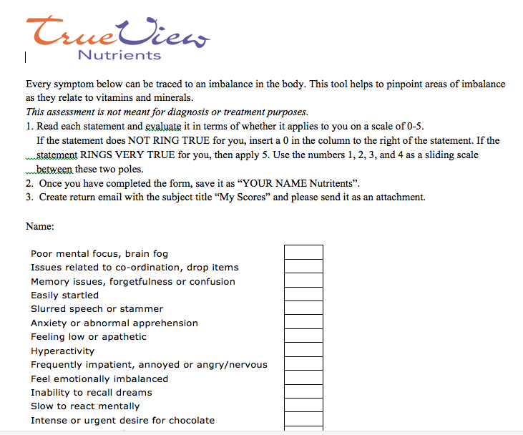
Send Word to Client

Slide 3

Open the Excel Workbook
Locate the Overview which is along the very bottom of the workbook

Slide 4
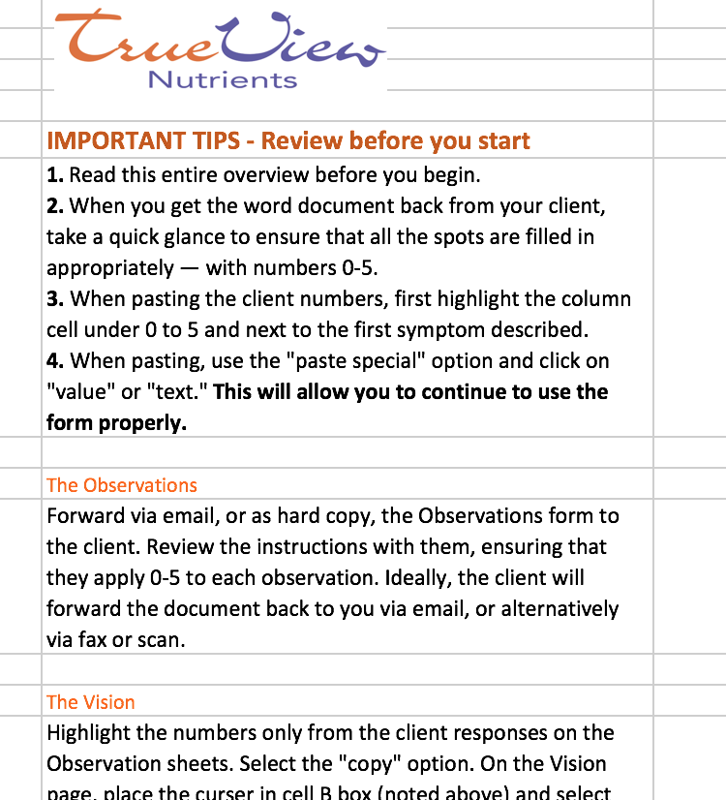
Read the Overview

Slide 5
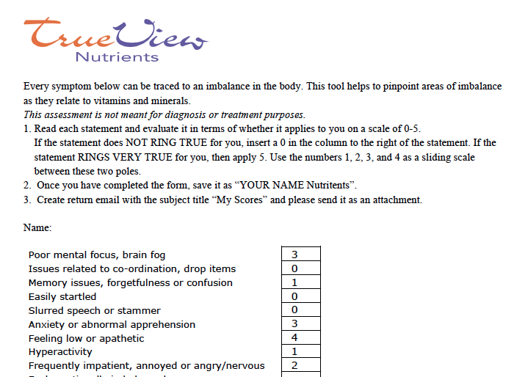
Ensure completed document

Slide 6
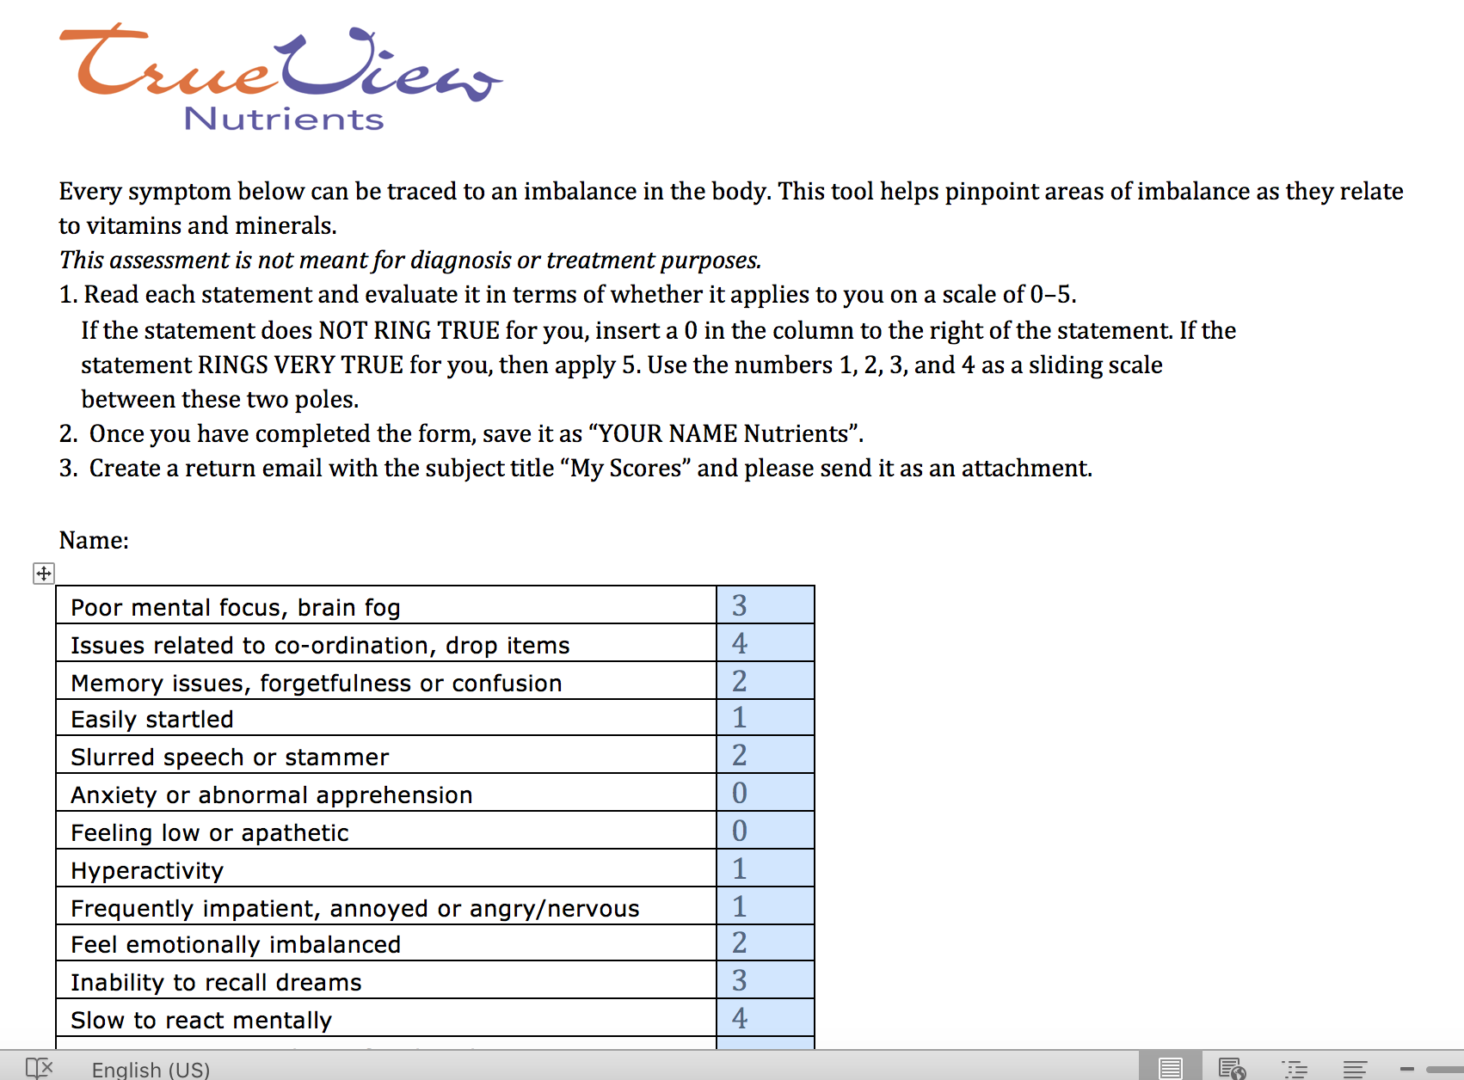
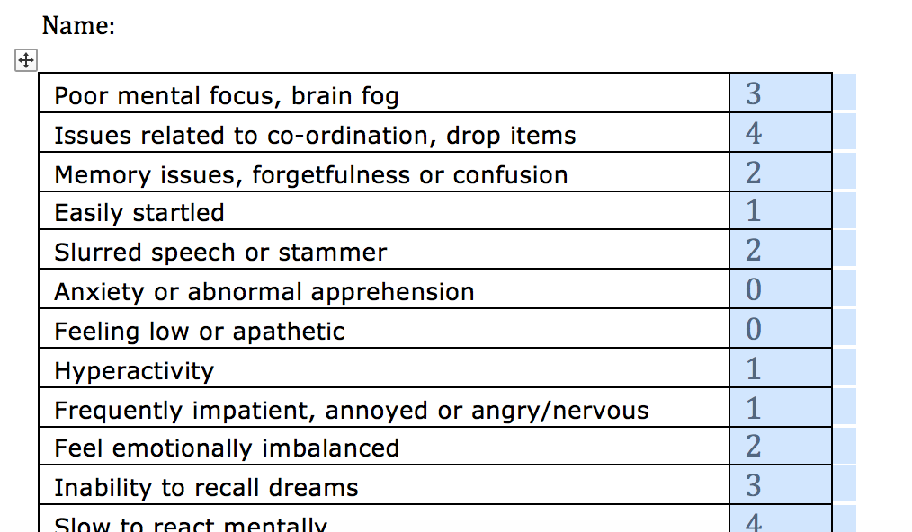
Copy the client information

Slide 7
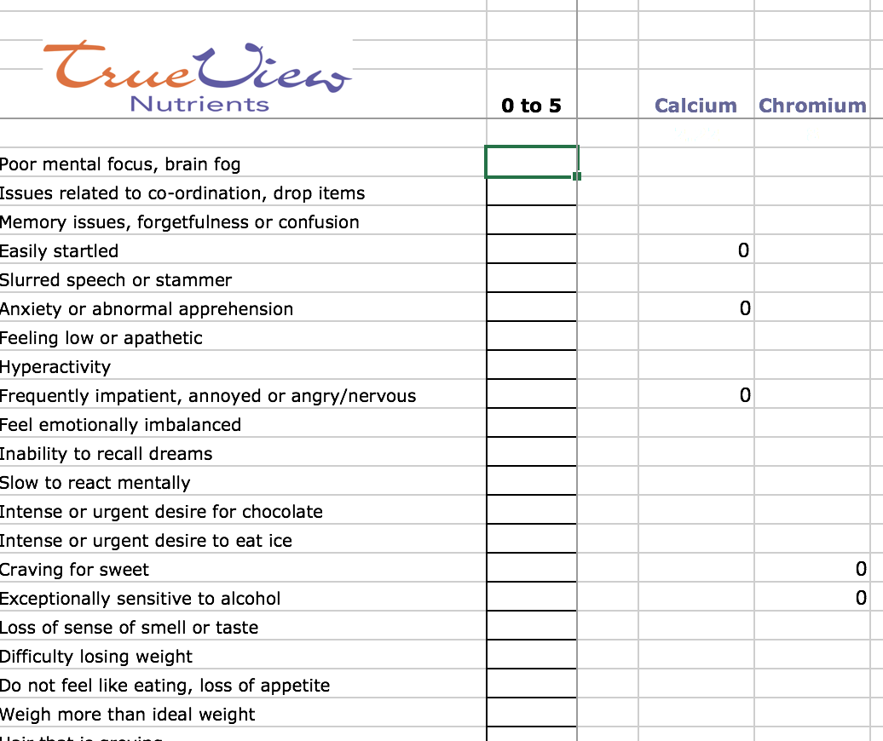
Locate/ open the Vision page

Slide 8
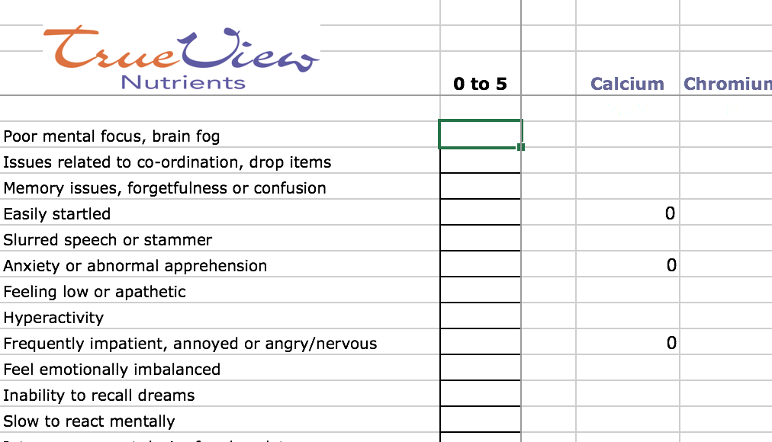
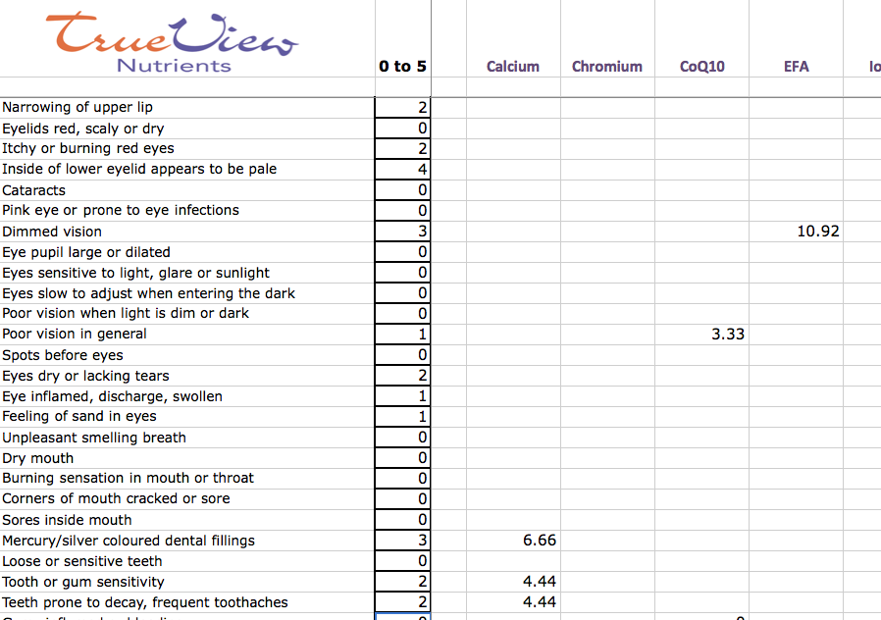
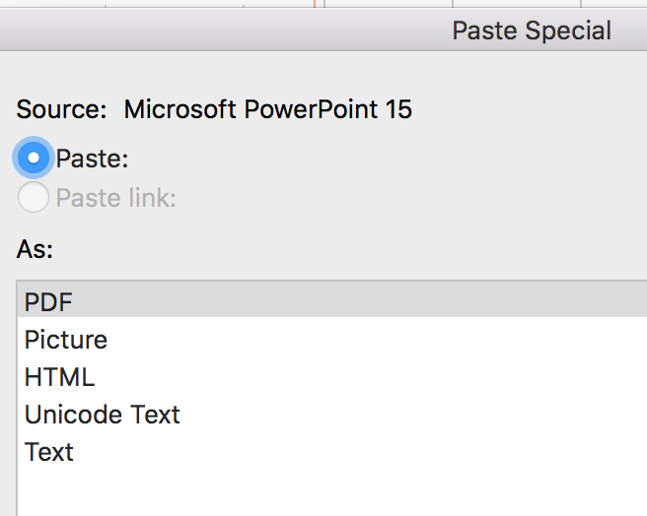
Paste “special” into the Vision
Paste Special using Value or Text

Slide 9
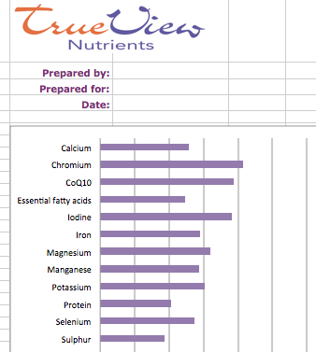
Locate At a Glance
There are no numbers
There is no math
The only thing to pay attention to is:
The Longer the Line, the More Out of Balance
This is the place to start putting the
pieces together

Slide 10
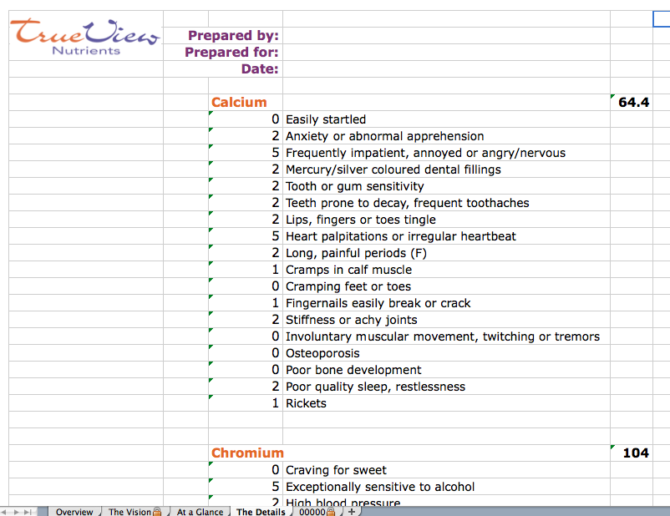
The Details

Slide 11
Handling the data
Perhaps print the At a Glance for your file
Use the “save as” function to archive
Important to leave the original document intact

Slide 12
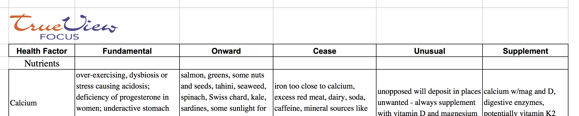
Refer to the Focus
Fundamental Onward Cease Unusual Supplement

